Slide 1

Expense Tracking Application
Tanmay Poyekar 20104053
Jai Rao 20104097
Sahil Vishwakarma 20104089
Project Guide
Ms. Manjusha Kashilkar

Slide 2
Contents
Introduction
Objectives
Scope
Literature Survey
Proposed System
Project Outcomes
Block Diagram
Use Case/DFD
Technology Stack
Suggestions in Review-1
Result and Discussion
Conclusion and Future Scope
Reference

Slide 3
1. Introduction
A Expense Tracking Application is a one kind of digital diary that helps to keep an eye on all of our money related transaction.
Problem Identified :
At the end of the month we start to have money crises.
Lack of proper planning of our income.
Person has to keep a log in a diary .
All the calculations needs to be done by the user.
Proposed Solution :
Eliminate the manual Work.
User can Set Budget of each Expense.
Visual Representation of Income & Expense.

Slide 4
2. Objectives
To manage your personal finance daily and budgeting in simplest way
To make Flow-oriented interface to make it quick to enter and easy to enter the expense details and get an accurate picture of your expense and budget everytime.
To save money for pre-defined expenses.
To spend only on priorities.

Slide 5
3. Scope
It is usable by anyone who are willing to manage their expenses and aiming for the future investments and many more .
Every user of the application has the option to add incomes and expenses accordingly.
There is not any range criteria or any kind of profession or gender are focused, it will be used hugely.

Slide 6
4. Literature Survey
(Girish Bekaroo, 2007) did a research on intelligent online budget that manages the expenses and used to give the graphical analysis of data..
(R N Rajprabha, 2017) created an android version of family budget manager with later evolved in PDA and tablet features.
Researchers of Nandha and Anna university (2016) created an android version of expense manager in with they used post and remark techniques for underlining the expenses and some of the data mining features for analyzing the market value well.

Slide 7
5. Proposed System
1. Track income & expenses
This can give you a clear picture of how much you are earning and spending. You can evaluate if you are making more expenses and where you need to cut.
2. Summary of Data
User get the Visual representation of added data which make the app user-friendly.
3. Eliminate the manual work of calculating Expenses.

Slide 8
6. Project Outcomes
Users can manage all financial data .
User can track all expense and income category wise.
User can Create category and can record all expenses and income.
Users can easily review the reports anytime.
Users can delete records of their expenses and income at anytime according to their use.

Slide 9
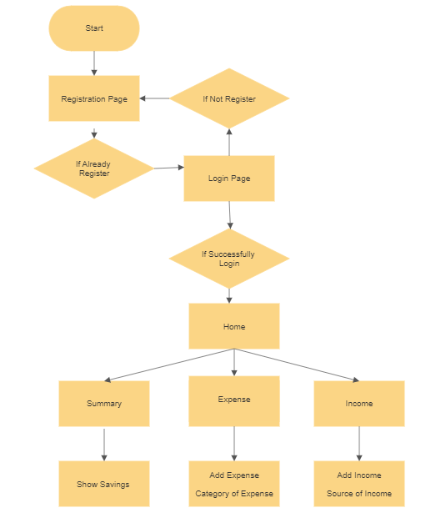
7. Flow Chart

Slide 10
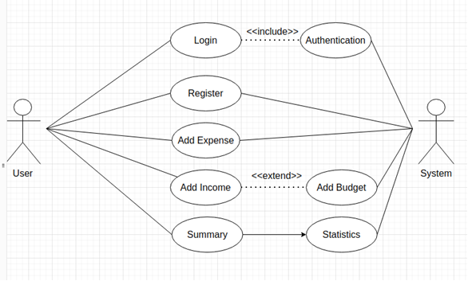
8.Use Case/DFD

Slide 11
9. Technology Stack
Frontend:
HTML
CSS
Javascript
Backend:
Javascript
Database:
MySql
Operating System:
Windows

Slide 12
10.Suggestions in Review-1
To make interface more user friendly as the user use our application they should be easily able to use every part with ease.
To add investment feature with our expense tracker which will add more value to the application.

Slide 13
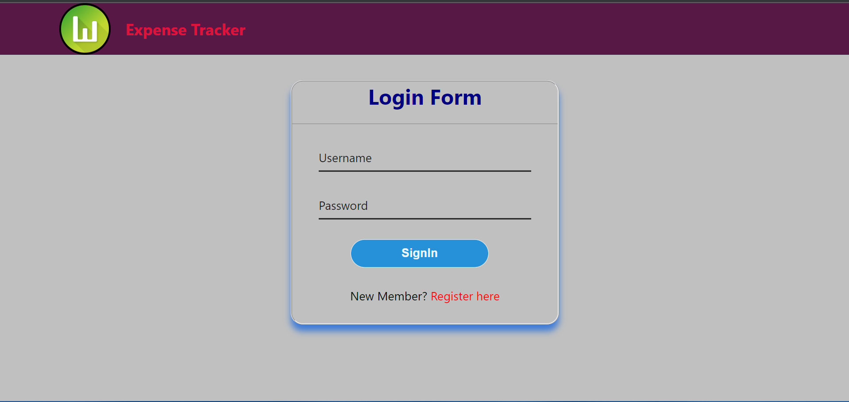
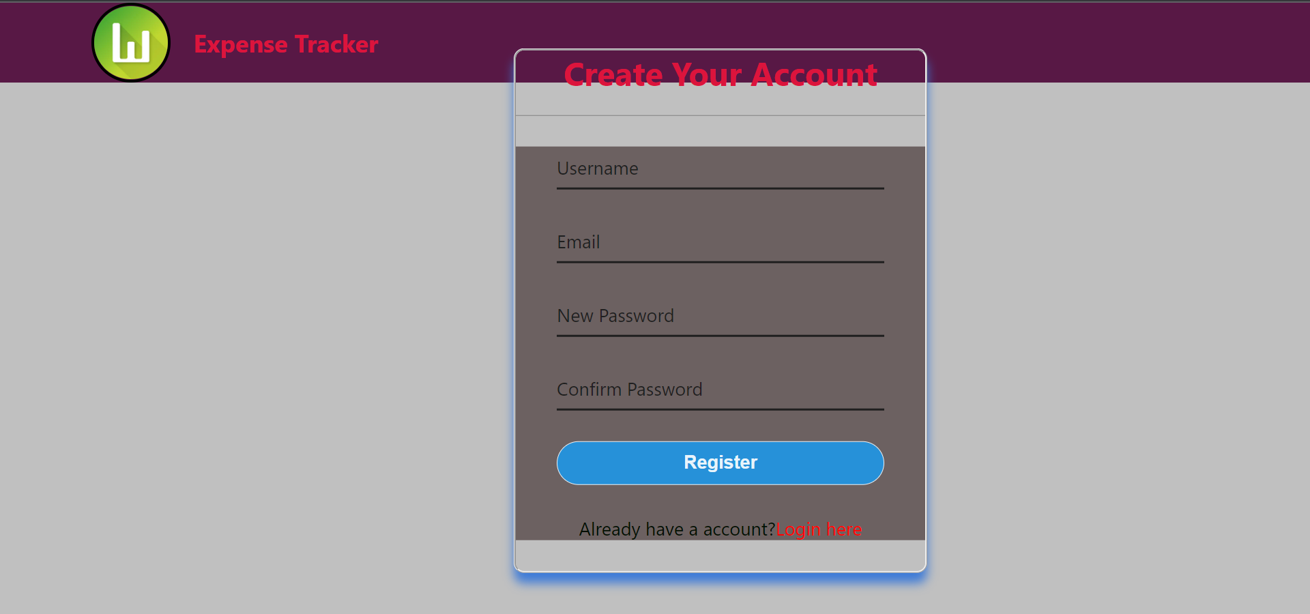
11.Result and Discussion

Slide 14
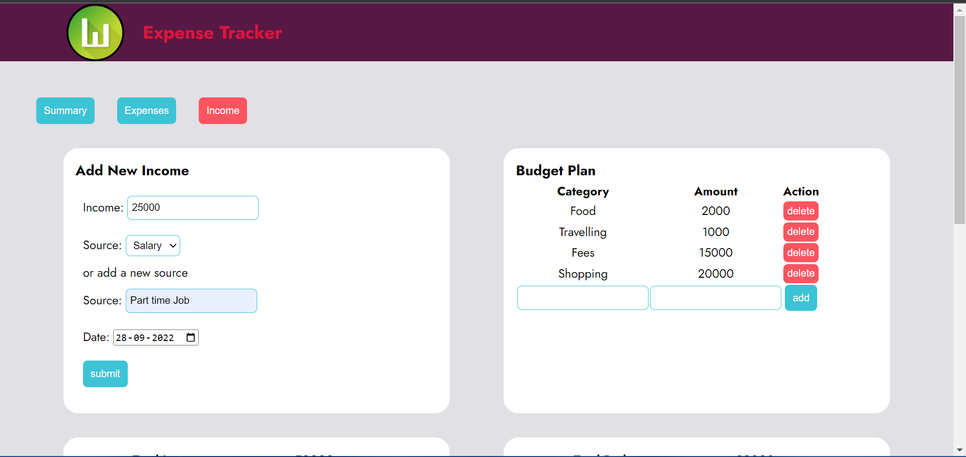
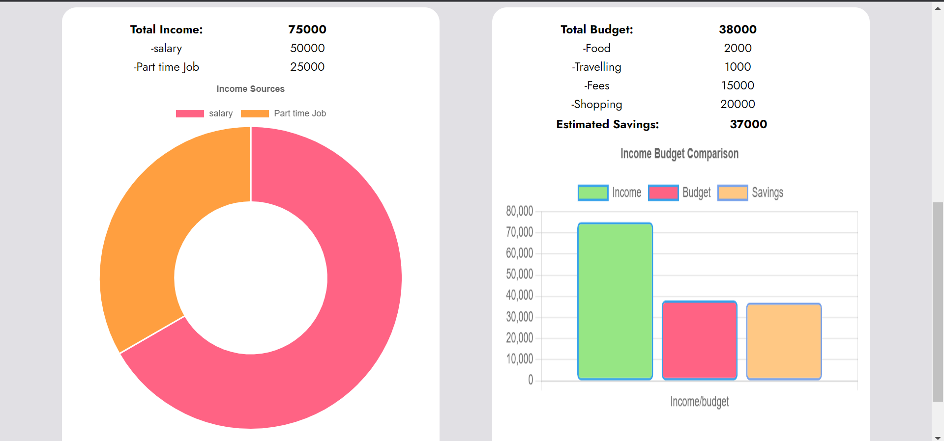
11.Result and Discussion

Slide 15
12.Conclusion
Using this application user will be able to manage the cost of their daily expenditure . It will guide them and aware them about their daily expenses . It will prove helpful for the people who are frustrated with their daily budget management . In short this application will help its users to overcome the wastage of money.
Future Scope
Sending notifications for our daily expenditure.
Investment feature will be added to the income section where user will have more knowledge with what to do with their money and have a better tracking results in their expense report.
Making report of your daily income and expenses in pdf format.

Slide 16
13.References
Y. Anitha, R. Ranjini, S. Gomathi, “Easy App for Expanses Manager Using Android”, International Journals of Computer Techniques, Volume: 3 Issue: 2, ISSN: 2394-2231 (March-April 2016).
N. ZahiraJahan MCA., M. Phil, K. I. Vinodhini, “Personalized Expense Managing Assistant Using Android”, International Journals of Computer Techniques (IJCT), Volume: 3 Issue: 2, ISSN: 2394-2231 (March-April 2016)
Girish Bekaroo and Sameer Sunhaloo, “Intelligent Online Budget Tracker”, Computer Science and IT Education Conference (2014)

Slide 17
Thank You...!!

